Slide 1




Birlasoft Guidewire Testing Capabilities
Navigating
Change.
Powering
Progress.
© 2026 Birlasoft

Slide 2

01
Birlasoft Guidewire Testing Capabilities
02
Deep Guidewire Domain Expertise across Insurance Value Chain
03
GW Testing Maturity Assessment Framework
04
QA Enablement Across the Guidewire Lifecycle
05
Test Design Accelerators
06
Augmenting GW testing lifecycle using Lynx
07
Success Story

Slide 3







Guidewire Testing Capabilities
Business Domain
Guidewire Solution Coverage
Service Offerings
Key Tools
Personal & Commercial Auto
    Advisory led Testing Center of Excellence
    Consulting
  QA Maturity Assessment
  Test Strategy definition based on GW SurePath (GTF)
  Tools Optimization and Implementation of Guidewire Test Frameworks
    Managed Testing Services
  Test Transformation Initiatives
Homeowners & Commercial Property
Guidewire Testing Framework
Claim
Center
Personal & Commercial Umbrella
Policy
Center
Billing
Center
    Delivery
  Functional Testing for Customized Modules
  Integration Testing (CoreLogic, Billing and Downstreams)
  Regression testing for OOTB Functionalities
  End-End Testing of Entire Business Process
  Lifecycle Automation across testing phase
  Data Migration Testing
  Performance, Usability, Accessibility Testing
100+
Associates
100+
Associates
Inland Marine
Core
Systems
Third-party systems
5+
Active Accounts
Customer
Engage
10+
Active GW Customers
Specialty
Digital & Engage Layer
Integration & Ecosystem
10+ Years of
Customer Relationship
API & Messaging
    Type of Engagements
  Guidewire Cloud Migration
  GW Version Upgrade & Support
  Database Upgrade & Migration
  Maintenance Release
  New Implementation & Optimization
  Guidewire Digital & Integrations
5+
Accelerators
General Liability
Product
Engage
100+
Projects Executed
Data
Exchange
Workers Compensation
100+
Projects Executed
100+
Resource GW, CPCU, AINS,
AIT, AIDA Certified
Though PricingCenter and UnderwritingCenter are part of Guidewire’s released offerings, we have highlighted only those products where we have hands-on experience and expertise

Slide 4
Deep Guidewire Domain Expertise across Insurance Value Chain
Policy
Submission
Quote
Bind
Issuance
Endorsement
Renewal
Cancellation
  Captures insured details, coverage, locations, vehicles, etc
  Calculates premium based on rating and coverages
  Confirms the insured’s acceptance of the quote
  Policy is formally issued after binding along with Policy number & forms.
  Mid-term change to an active policy with forms.
  Automated re-underwriting during renewal processing with forms.
Early termination of an in‑force policy with forms
Billing
Billing Instruction
Scheduling
Commission
Invoicing
Policyholder Service
Payment/
Disbursement
Close
  Receive notice of new or changed policy
  Create account, assign plans, process down-payment, & installments
  Calculate commissions / automated disbursements
  Calculate present and future invoices
  Preview and make changes at any time
  Automate distribution of payments and Outgoing payment processed.
  Validate all receivables have been cleared
Claims
New Claim Entry
Segment/ Assign
Investigate/Evaluate
Reserves/Payments/Recoveries/
Services
Litigation/Negotiation
Close
  Wizard-based; dynamic, response-driven questions; policy integration
  Rules-based segmentation and assignment to one or more claim professionals
  Best practices automatically encompassed in work plan and continuously monitored
  Robust financial management; granular reserve, Services and payment tracking; subrogation.
  Litigated matters on claim and negotiation details tracked
  Business rules ensure all appropriate steps taken before claim closure
Level 5
Level 4
Level 3
*Competency Levels are defined from L1 to L5 basis number of domain assets for the functional area

Slide 5
Guidewire Testing Assessment Framework
Our comprehensive Guidewire Testing Maturity Assessment Framework evaluates the end-to-end testing ecosystem across functional, integration, data, and rating validation to ensure quality, coverage, and release confidence. It identifies gaps in processes, tools, and governance, enabling a shift toward intelligent automation, traceability, and risk-based testing. The outcome is a scalable, future-ready testing model that improves defect prevention, accelerates releases, and enhances business assurance.
20 PROCESS AREAS
L4
DOMAIN EXPERTISE
L3
TEST ACCELERATORS
L2
L1
GUIDEWIRE EXPERTISE
BEST PRACTICES &
LESSONS LEARNT
L1 - Initial
L2 - Managed
L3 - Defined
L4 - Optimized
4 MATURITY LEVELS

Slide 6
QA Enablement Across the Guidewire Lifecycle
 | GW Scenarios → | Transition to Guidewire Cloud | GW Upgrade & Support | Database Upgrade & Migration | Maintenance Release | New Implementation & Optimization | Guidewire Digital
S. No. | QA Services ↓
QA Advisory & Governance |  | ✓ | ✓ | ✓ | ✓ | ✓ | ✓
1 | QA Advisory, Consulting & Strategy
Core Testing Services |  | ✓ | ✓ |  | ✓ | ✓ | ✓
2 | Functional Testing (GW), Rate Testing, End to End Testing [Involving 3rd Party Apps – Business Process Level]
3 | Business Acceptance Testing | ✓ |  |  | ✓ | ✓ | ✓
Automation Testing |  | ✓ | ✓ | ✓ | ✓ | ✓ | ✓
4 | Selenium & UFT, Guidewire framework, Continuous Testing
API & Integration Testing |  | ✓ | ✓ |  | ✓ | ✓ | ✓
5 | API & Microservices Testing
6 | Service Virtualization | ✓ |  |  |  |  | ✓
Multi-Channel & User Experience Testing |  |  |  |  |  |  | ✓
7 | Multi Channel Testing, Cross Browser Testing
Data & Migration Testing Services |  | ✓ | ✓ | ✓ | ✓ | ✓
8 | Data Centric Testing [ETL/Data Migration], Time Travel Testing
9 | Test Data Management | ✓ | ✓ | ✓ | ✓ | ✓ | ✓
Non-Functional Testing (NFT)
10 | Performance Testing | ✓ |  | ✓ | ✓ | ✓ | ✓
11 | Security Testing | ✓ |  |  |  | ✓ | ✓
12 | Usability and Accessibility Testing |  |  |  |  |  | ✓

Slide 7
Test Design
2230 Reusable Test Scripts available across P&C Lines of Business, covering major functionalities

Slide 8



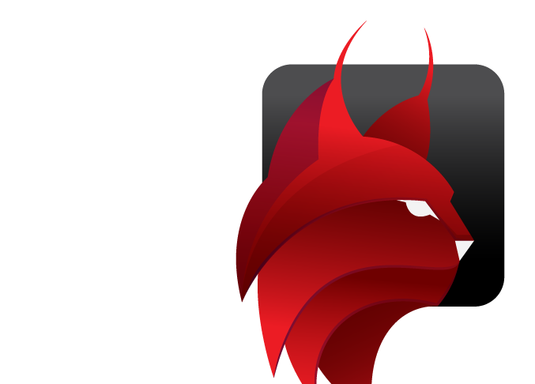
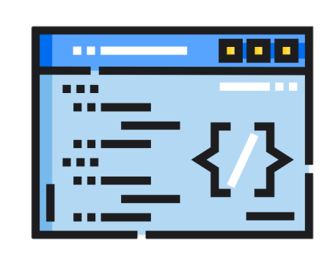
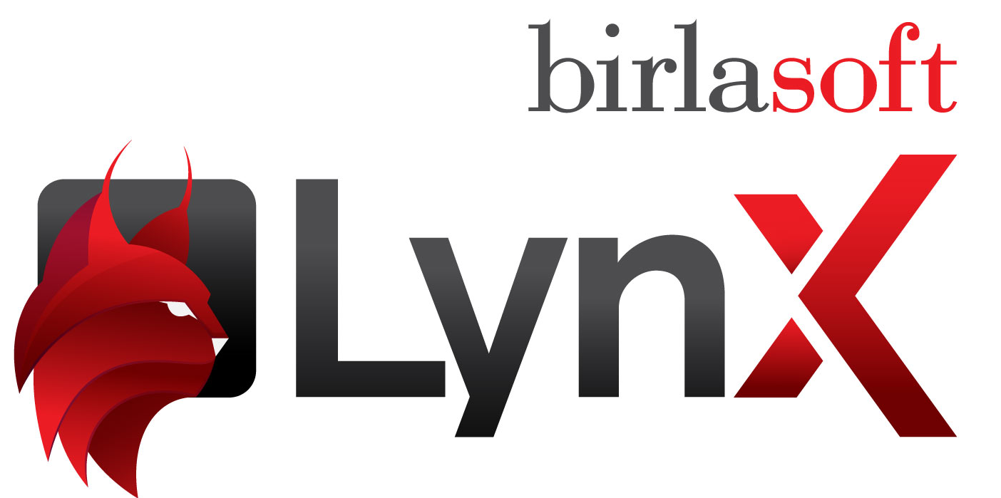
Augmenting GW testing lifecycle using Lynx
Faster rate & product rollouts
Test Planning
Assistant
Manual Test case
Generation
AI-driven Approach to Quality across Lifecycle
Improved premium accuracy
Quality scoring of
requirements
Autonomous Test
Automation
Safer Guidewire
upgrades
Test Data
Generation
Self healing
Test Execution
Stronger compliance confidence
Defect Prediction
& Prevention
Quality Pulse
Dashboard
Better policyholder & agent experience

Slide 9

Success Story - Guidewire Assurance for a Global insurance company
OBJECTIVES
SOLUTIONS
HIGHLIGHTS
Wanted to decommission the existing legacy system and replace with Guidewire PolicyCenter & ClaimCenter
Supported the Guidewire Version 8 , 10
Our Scope to provide QA services (Manual and Automation Testing) for this implementation
  Migration of existing DCT policies (500+) to Guidewire Policy Center.
  BA/QA model to develop of automation scripts with for Guidewire PC & CC expertise
  Usage of ADO effectively for Test Preparation, Execution, Defects Logging/ Tracking to closure, Release management etc.
  Shared repository (TFS) which provided better control on test management.
  Co-ordination with Manual team and experienced resources to understand legacy source codes
UAT
Zero defect Leakage to UAT
Automation of Regression Test cases
3500+ cases automated using BDD framework in Selenium (across LOBs)
QA Team
100+ strong Guidewire QA Team
About Client
A leading global provider of property, casualty, and specialty insurance and reinsurance, operating across multiple international markets with headquarters in Bermuda. It maintains strong financial strength ratings from major agencies, reflecting its stability and continued global expansion
Products
40+ Products (Comm and Specialty Lines) went into production on Guidewire PolicyCenter
CHALLENGES
VALUE ADDS
  Lack of Functional knowledge and expertise for Guidewire PC & CC Application.
  Unclear Test Cases and not as per updated requirements.
  Lack of proper requirement mapping documents and knowledge transition.
  Testing of multiple LOBs going on simultaneously with aggressive timelines.
  Customer is using multiple Insurance product GW, DCT and wanted a vendor with expertise on both of these.
Performance Testing of GWPC by existing team using Load Runner.
Minimum maintenance effort and cost of automation scripts and framework components due to data driven automation framework
Effective documentation was done so anyone can easily change or understand the logic if required.
Effort/Cost Savings
24% effort/cost saving due to automation using BDD framework in Selenium
Shared Test
Assets Bank
70% of reusable components with in 6 weeks by focusing on Framework modification and reusable components creation
Annual Cost Benefit
$1M Expected Annual cost Benefit

Slide 10

Navigating
Change.
Powering
Progress.
Thank You
Q1FY’27
Birlasoft.com
© 2026 Birlasoft

Slide 11

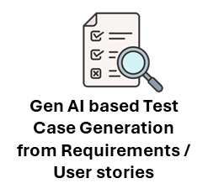
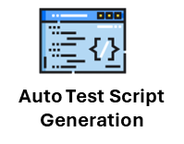
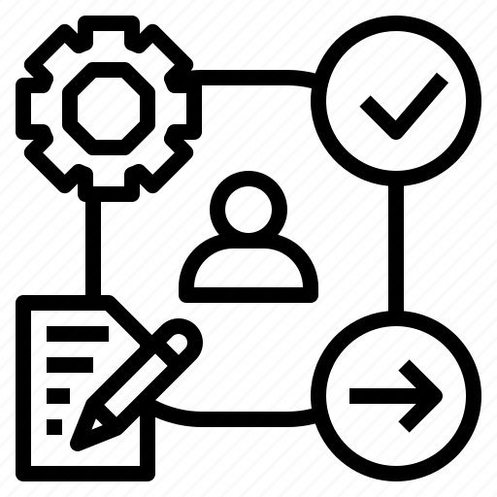



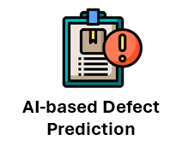





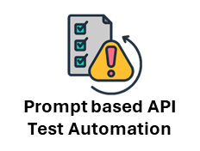
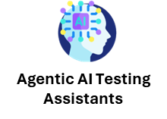



Our Testing Capabilities
  26+
  Years of
  Delivery Excellence
  100+
  Active Global Customers
~1980
Testing Professionals
18+
Large Transformative Testing CoEs
10+
Continuous Testing Solution Accelerators
Testing Themes & Our Offerings
Snapshot of our IPs & Solutions Lens
Partnerships
Next-Gen Testing Services
Enterprise Systems Testing
  Legacy Modernization & Cloud Testing
  ERP & Package Applications Testing
  Multi Channel & CX Assurance
  Digital Commerce Testing
  Data and AI Testing, IIOT Testing
  Platform Engineering
Business Resilience Testing
Connected Enterprise
Birlasoft Lynx
AI-based Test Platform
Test Consulting
Quality Engineering
  Shift Logical
  GenAI-led Automation
  Unified, AI enabled, TDD/BDD enabled, Data
  Test Process & Tools Transformation
  Cognitive QA
  (AI in Testing)
Recent Industry Recognitions
  Quality Enablement
  (Agile Transformation)
n
  Recognized as a ‘Leader’ in Continuous Testing Specialists (US Region) in ISG Provider Lens™ Quadrant study on AI-driven Next-Gen ADM Services 2025 (5th Consecutive year)
  Recognized as a ‘Major Contender’ Quality Engineering (QE) Services for AI Applications and Systems, Everest Group PEAK Matrix® Assessment 2024
  DevSecTestOps
n
n
  GenAI led TCoE Transformation
  (Lean TCoEs, PODs, TAAS)
n
  Testing Lifecycle Digitization
n
  Recognized as a ‘Major Contender’ Quality Engineering (QE) Services for Mid-market Enterprises, Everest Group PEAK Matrix® Assessment 2024

Slide 12
Guidewire Rating Testing Best Practices
Multi-Parameter Rating Calculations
Test scenarios where multiple rating parameters (e.g., age, location, vehicle type) interact to calculate premiums.
Verify the accuracy of the rating engine when different combinations of parameters are used.
Policy Changes and other transactions
Test how the rating engine handles mid-term policy changes, such as adding or removing coverage, changing deductibles, or updating insured values.
Ensure that endorsements are correctly reflected in the premium calculations.
Discounts and Surcharges
Validate the application of various discounts (e.g., multi-policy, safe driver) and surcharges (e.g., high-risk area) based on different criteria.
Check that the rating engine correctly applies these adjustments to the base premium.
Tiered Rating Structures
Test scenarios involving tiered rating structures where premiums vary based on predefined tiers (e.g., credit score tiers, driving record tiers).
Ensure that the rating engine accurately assigns policies to the correct tier and calculates premiums accordingly.
Regulatory Compliance
Verify that the rating engine complies with local and national insurance regulations, including rate filings and approved rating factors.
Test scenarios where regulatory changes impact the rating calculations.
Integration with External Systems
Test the integration of the rating engine with external data sources (e.g., credit bureaus, vehicle databases) to fetch necessary rating information.
Ensure that data from these sources is correctly incorporated into the rating calculations.
Edge Cases and Negative Testing
Create scenarios that test the limits of the rating engine, such as extreme values for rating parameters or invalid data inputs.
Ensure that the rating engine handles these edge cases gracefully and provides appropriate error messages.
Scenario-Based Testing
Develop real-world scenarios that mimic actual policyholder situations, including claims history, policy renewals, and cancellations.
Validate that the rating engine produces consistent and accurate results across these scenarios.
Custom Workflows
Test custom workflows specific to business processes, ensuring that the rating engine supports the customizations effectively

