Slide 1





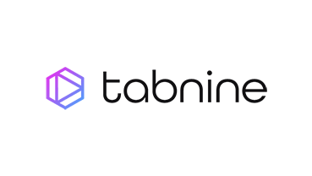

































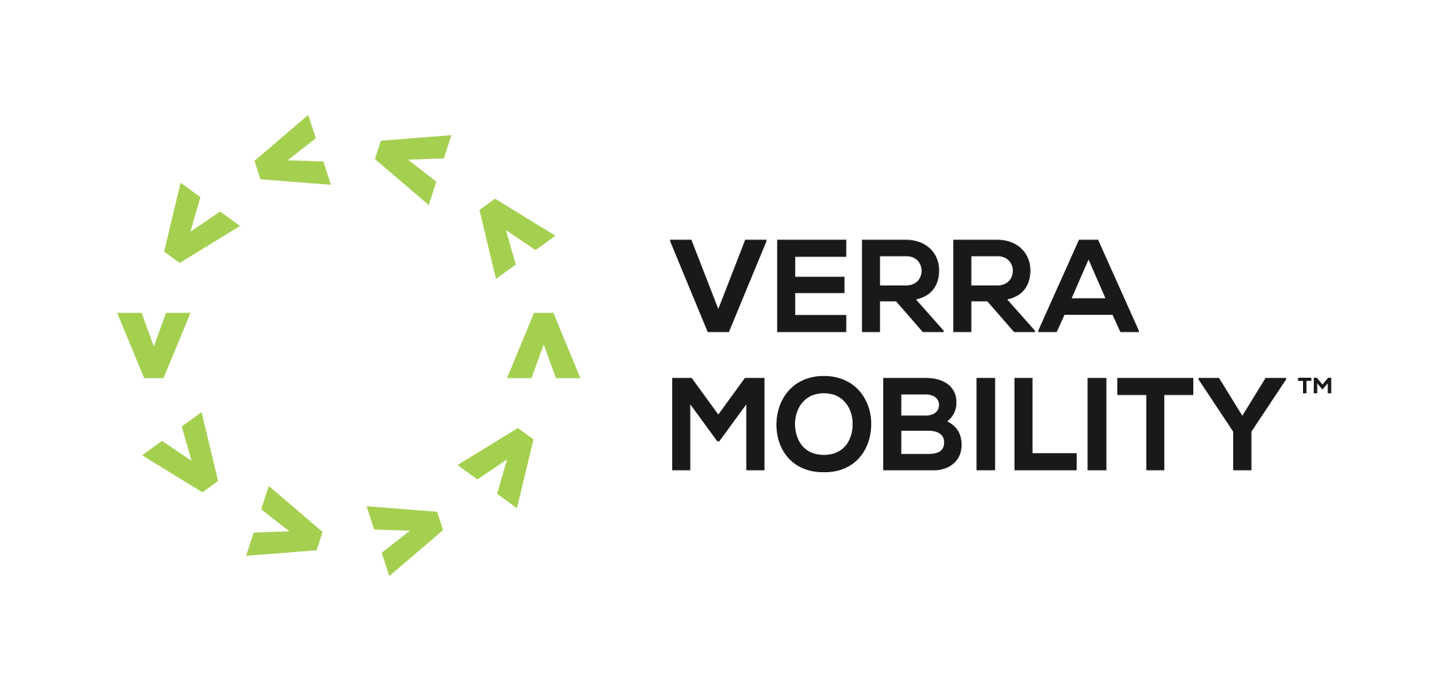
Birlasoft Cogito Agentic AI Practice – Trusted Innovation Partner
Key Capabilities & Value for the Enterprise
Agent Readiness & Enterprise Assessment
Low-Code, No-Code & Pro-Code Agent 2 Platform
Enterprise Agent Orchestration
Cognitive Data & Knowledge Fusion
Intelligent Business Process Automation
Strategic AI Governance & Scaling
Enterprise AI Maturity Scorecard
Visual Agent Designer
Intelligent Workflow Engine
Intelligent Data Harmonization
Process Discovery & Mining
AI Ethics & Compliance Framework
Use Case Prioritization Matrix
Industry Agent Library
Legacy System Integration
Contextual Knowledge Mining
Intelligent RPA Enhancement
ROI Tracking & Portfolio Management
Rapid Pilot Strategy
Enterprise Security Framework
Real-time Performance Analytics
Predictive Decision Support
Business Rules Engine
Global Scaling & Change Management
Key Accelerators
Offerings
No-Code Studio
Visual development platform
Agent Marketplace
20+ pre-built solutions
GenAI Observability
360-degree monitoring
Executive AI Readiness Assessment
90-day strategic roadmap
Rapid Value Pilot Programs
30-day proof of concept
Enterprise Agent Marketplace
Pre-certified industry agents
Managed Agent Operations
24/7 enterprise support
Business Outcome Guarantees
Risk-sharing models
Change Management Excellence
Stakeholder adoption
Responsible AI
Ethics & compliance tools
Agentic Models
LLM workspace integration
Investment Tools
ROI decision support
Guaranteed ROI Models
Pay-for-performance pricing with measurable business outcomes and risk mitigation
Enabling Platforms
Engineering Depth
Top Customers & Wins in 2024-25
Key Analyst &
Partner Recognitions
Existing Agentic AI Programs
New / Upcoming Agentic AI Programs

Slide 2











Microsoft Teams
Cogito.AI - Birlasoft’s AI-First Engineering Platform
Composable Architecture
RAG-Enabled
Contextual
Intelligence
2
Autonomy
3
Integrations
1. Autonomous Mode | 4. Self Healing
2. Supervised Mode | 5. Multi-agent coordination
3. Auto Code Generation | 6. Adaptive Learning
1. IDEs | 4. Project Management Tools
2. Coding Assistants | 5. Enterprise Apps
3. CI/CD pipelines | 6. Code Repos
1
End-to-End SDLC Coverage
4
Customizability
1. Requirements Parser | 4. DevOps Flow Agent
2.BRD Summarizer Agents | 5. Defect Triage Agent
3.Code generator & Refactor Agent | 6. Documentation CoPilot
1. Agent Builder Studio | 4. Branding at will
2. Custom Agents | 5. Policy Engine
3. Pre-built Templates | 6. LLM’s
AI Guardrails Framework
Explainability
9
Platform
5
Enterprise Grade Maturity
1. Orchestration Engine | 4. Enterprise Architecture
2. Cross Environment | 5. Extensibility
3. Extensive Integrations | 6. Governance & Compliance
1. Enterprise Deployments | 4. Global Support
2. AI Product Engg. CoE | 5. Community Ecosystem
3. Extensive Documentation | 6. Proven Methodology
8
Advanced Team Collaboration
6
Performance
Native Agent Builder
Agent Marketplace
1. Shared Context | 4. Contextual Recommendations
2. Multi-Agent Environment | 5. Team Analytics
3. AI-led automation | 6. Multi-timezone Support
1. Code Quality | 4. Quality Gates
2. Automated task flow | 5. Performance Benchmarking
3. Faster development | 6. Real-time Analytics
7
Enterprise Security Standards
1. Secure Code Generation | 4. Standards Compliance
2. Vulnerability Scanning | 5. Audit Trails
3. Security Gates | 6. Zero Trust design

